Slide 1
DSD/BSE: 202.2
Project Proposal
Attendance Tracker Application
Notes:
Sunny

Slide 2
General Concept
A computer-vision based ‘attendance tracker’ system to automate the process of recording student attendance in a classroom.
Notes:
Sunny

Slide 3
Why is this application needed?
Students with higher attendance rates have better grades.
Accurately recording the attendance of a student is vital for ensuring the wellbeing and academic success of a student.
Traditional methods of attendance tracking generally rely on a teacher manually updating a spreadsheet or a pen and paper record at the start of class.
These processes are outdated, disruptive, and create many opportunities for input error - they can even be forgotten about completely.
Notes:
Sunny

Slide 4
Proposed Features
Connectivity to an external camera or video feed
Face and feature classification and extraction
Accurate comparison of extracted faces and/or features to a database of enrolled students
Real time updating of the class roll/attendance in the database
Notes:
Datu

Slide 5
Proposed Features
Administrator can add new students and remove students from the database
Alerts for low-attendance and viewable class attendance data
Teacher and Administrator Login/LogOut
User-friendly Desktop GUI
Notes:
Datu

Slide 6
Proposed Programming Framework Technology
Programming Languages
Python
Python Libraries
OpenCV
TensorFlow
GUI Implementation
Tkinter
Development Environment
VS Code
Anaconda Workstation
Notes:
Datu

Slide 7
Development Methodology:
Agile
Scrum
Scrum Roles
Scrum Master - Sunny
Product Owner - Datu
UX/UI Designer - Mandeep
Developer - William
Notes:
Datu

Slide 8
Project Management
Duration
16 Weeks
Communication Plan:
Daily Scrum Meeting and Stand Up (10 Minutes)
Weekly Scrum Planning/Retrospective
MS Teams for Digital Communication
Project Management Tools:
Trello (Scheduling)
GitHub (Version Control)
Google Drive/Docs (Documentation)
Notes:
Datu

Slide 9
Technical Design
Notes:
Willam

Slide 10
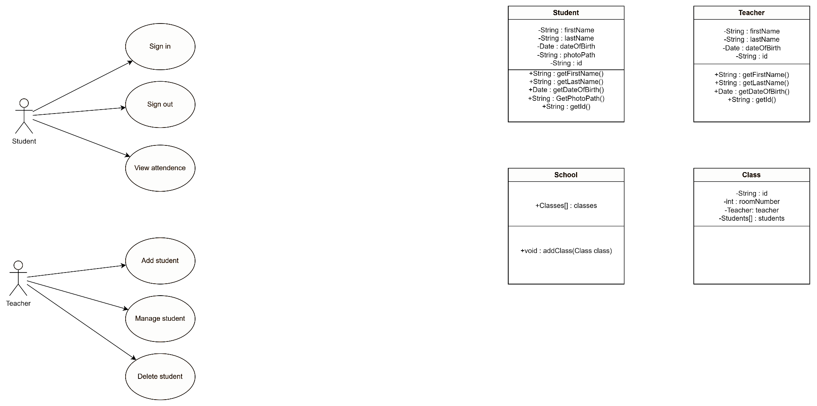
Notes:
Willam

Slide 11
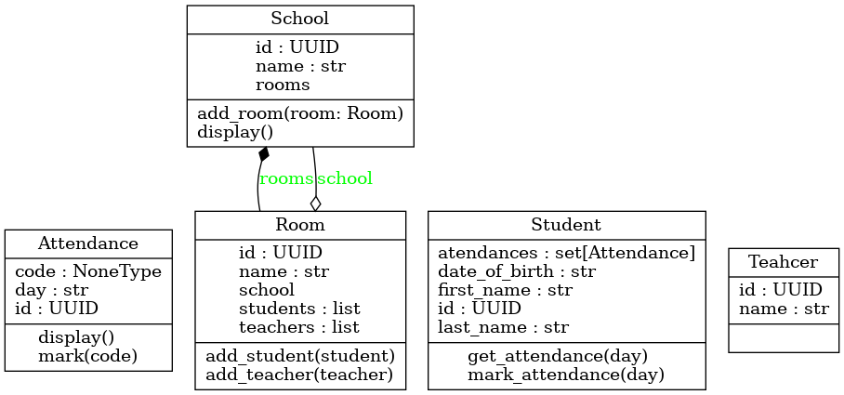
Notes:
Willam

Slide 12
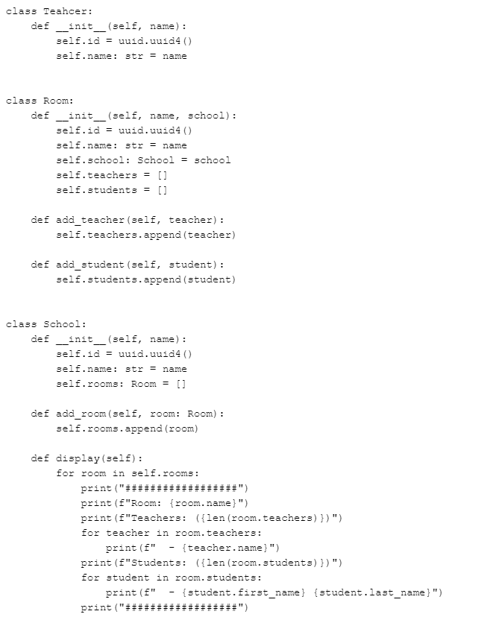
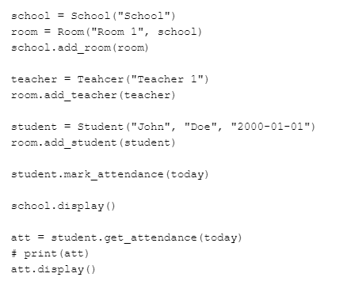
Notes:
Willam

Slide 13

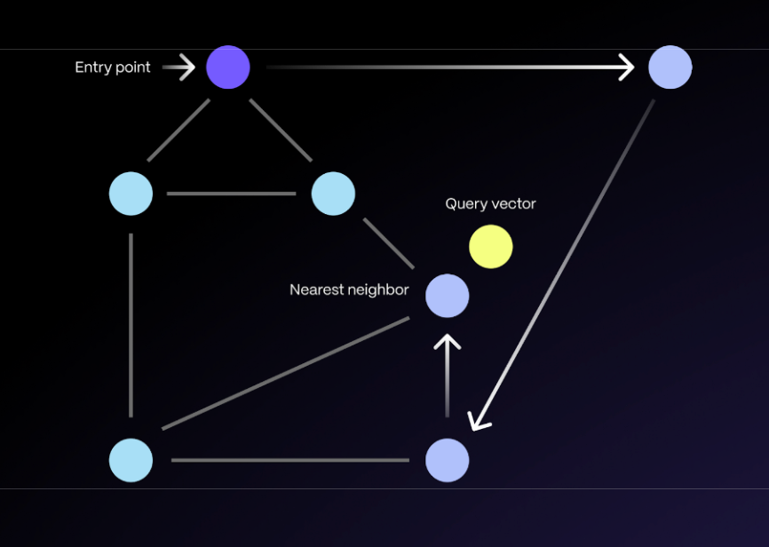
DeepFace
Postgres Vectors

Slide 14
Sentence | I | Like | Parks | Apples
I like parks | 1 | 1 | 1 | 0
I like apples | 1 | 1 | 0 | 1
Like Apples
Like Parks
(0,1)
(1,1)

Slide 15
UI/UX Design

Slide 16
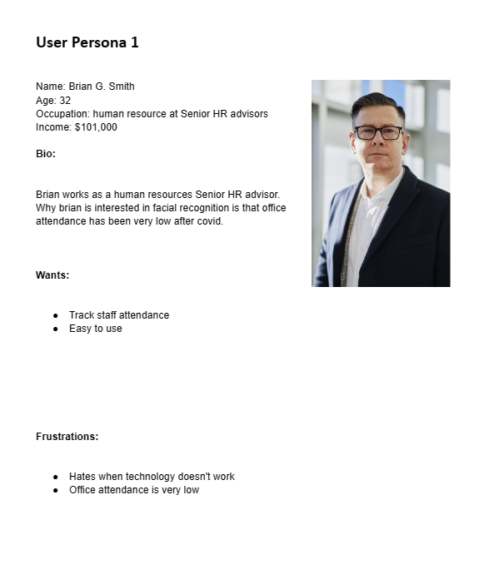
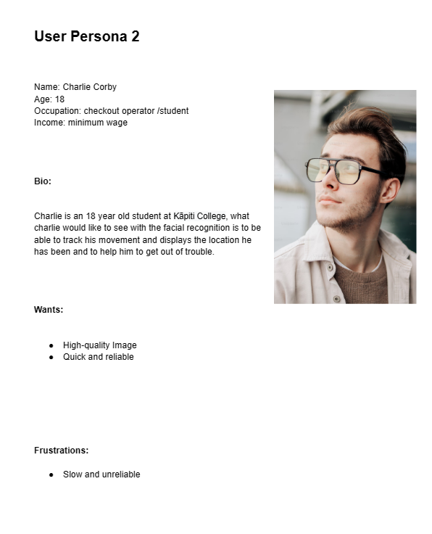
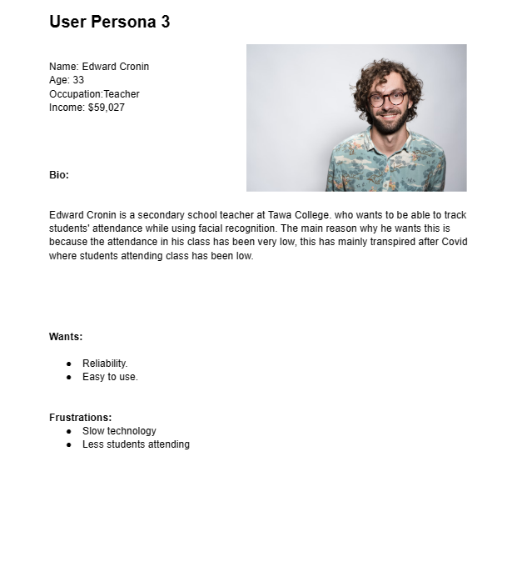
Notes:
Sunny

Slide 17
LoFi WireFrames
Notes:
Mandeep

Slide 18
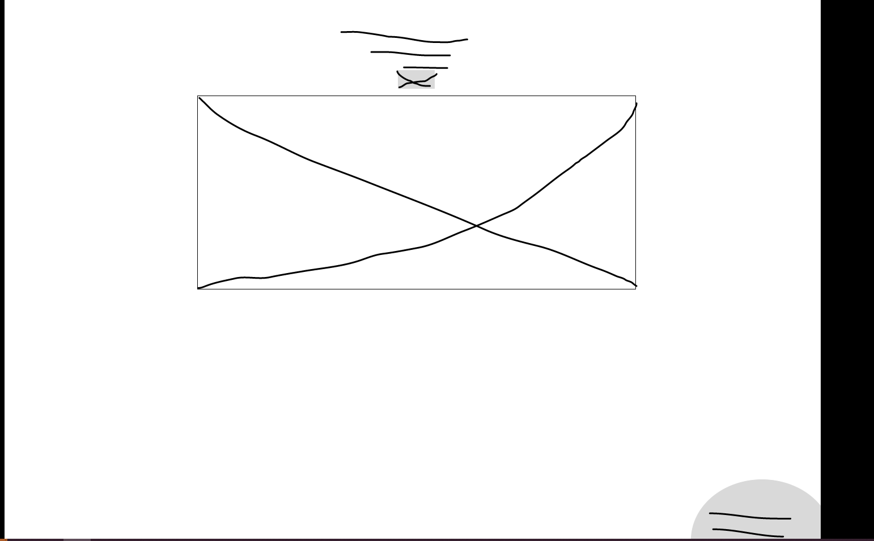
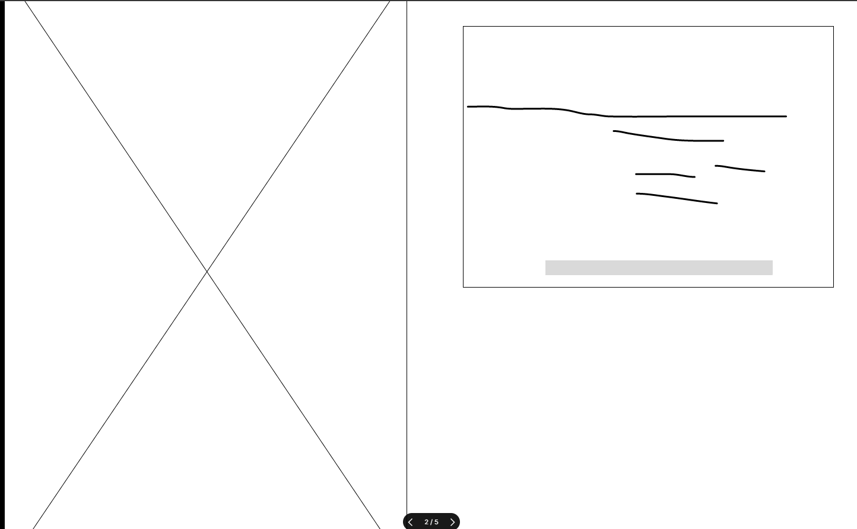
Notes:
Mandeep

Slide 19
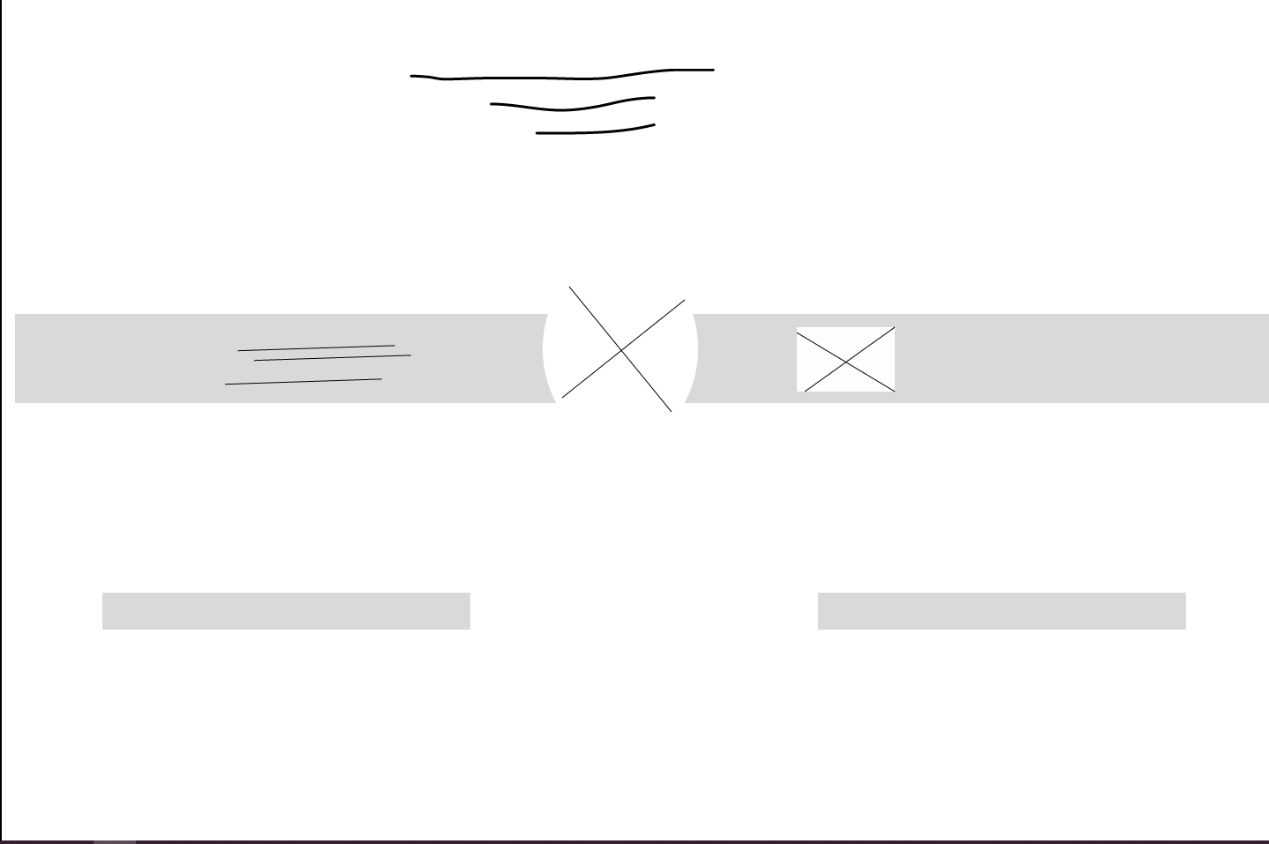
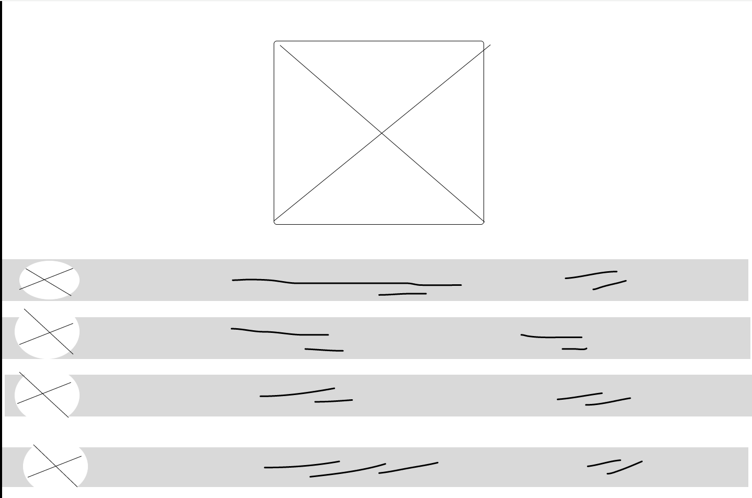
Notes:
Mandeep

Slide 20
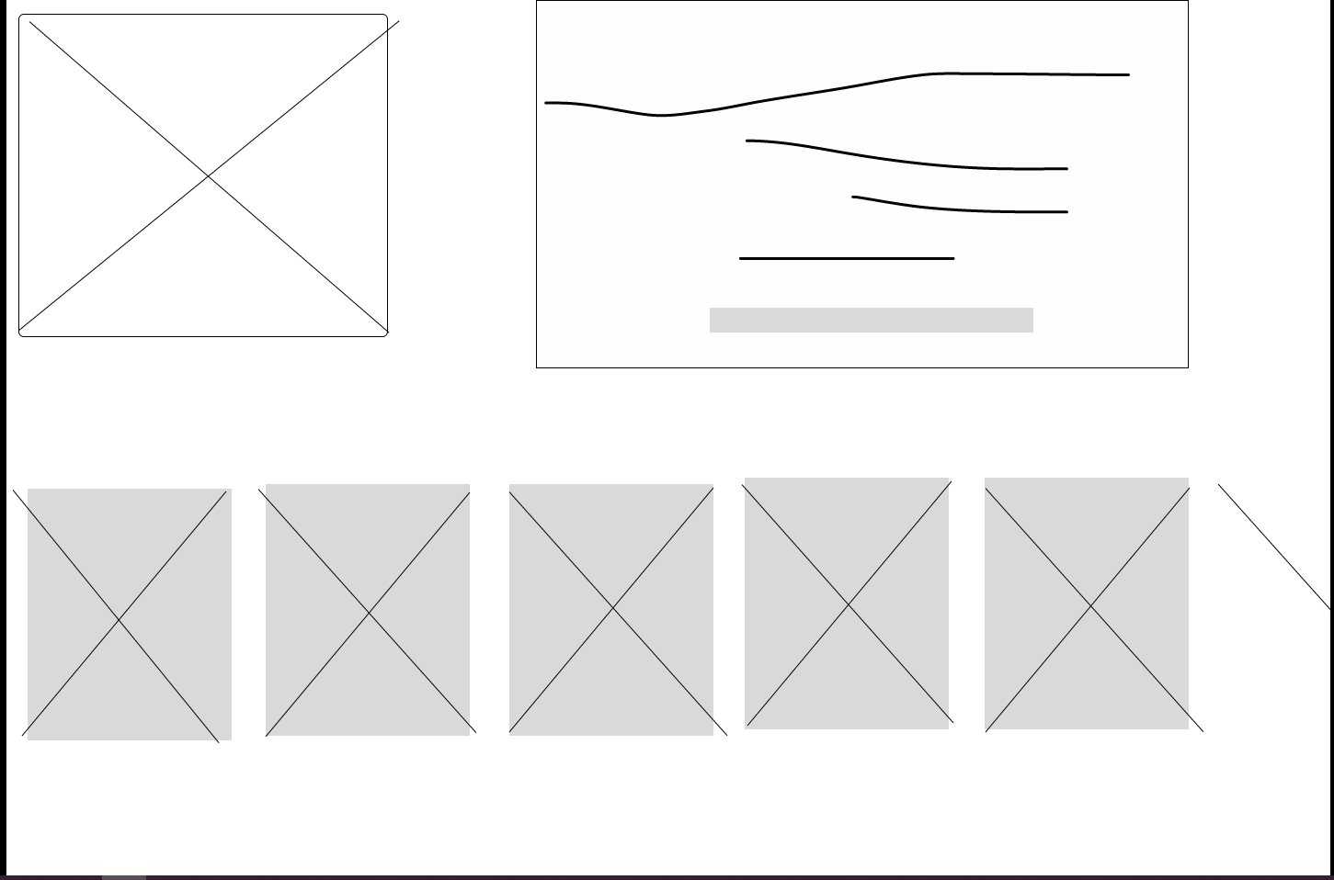
Notes:
Mandeep

Slide 21
LoFi User Testing
Notes:
Mandeep

Slide 22
Questions
Clarity of Navigation:
How intuitive was it to navigate through different sections of the attendance app?Were you able to easily find the features you were looking for?
Visual Appeal:
What are your initial impressions of the design aesthetics? Did the layout and visual elements enhance or detract from your experience?
3. Functionality Feedback:
Were all the necessary features present to fulfill your attendance tracking needs? Were there any features you expected to see that were missing?
4. Ease of Use:
Did you find the interface straightforward to interact with? Were there any specific actions or tasks that were particularly difficult or confusing?
Notes:
Mandeep

Slide 23
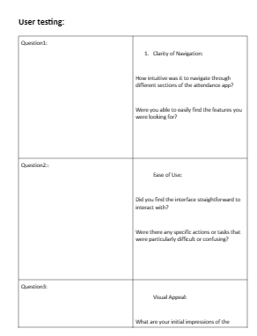
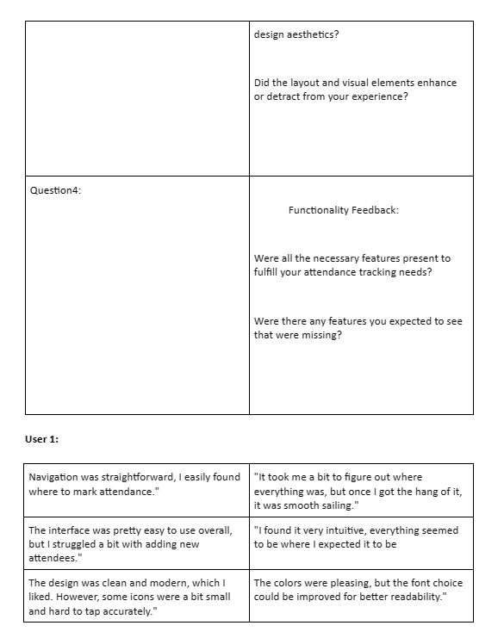
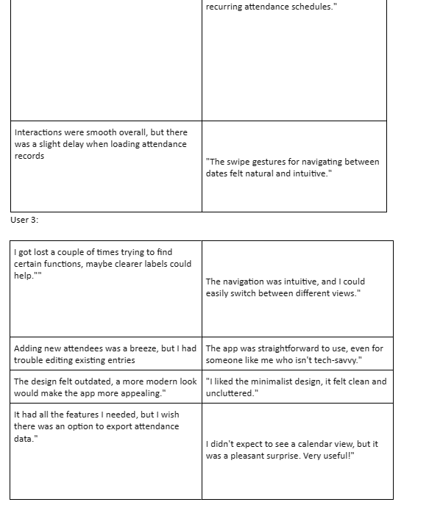
Notes:
Mandeep

Slide 24
Results of User Testing
Overall, users found the navigation of the attendance app to be clear and intuitive.
While a few minor suggestions for improvement were made, such as adding a home button for quicker access, the general consensus was positive, with users finding it easy to navigate through different sections and features.
Notes:
Mandeep

Slide 25
HiFi WireFrames
Notes:
Mandeep

Slide 26
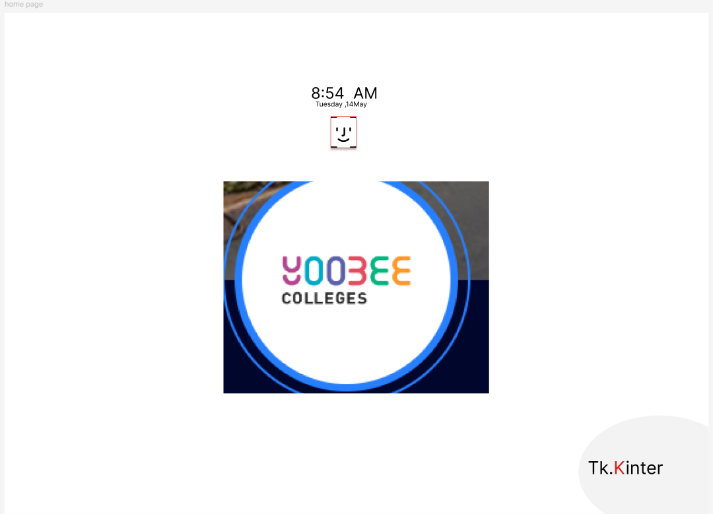
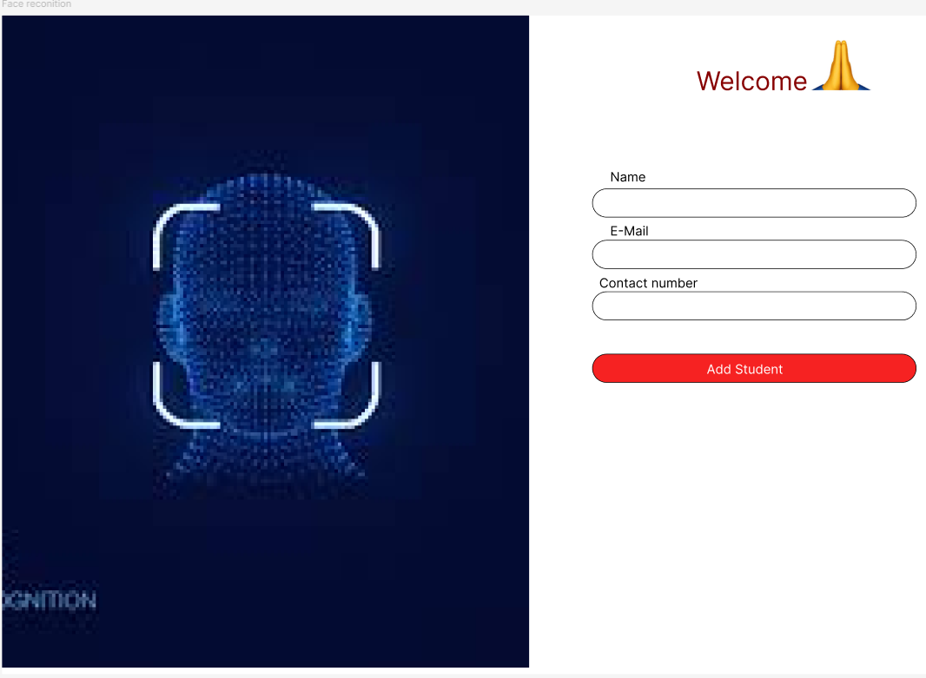
Notes:
Mandeep

Slide 27
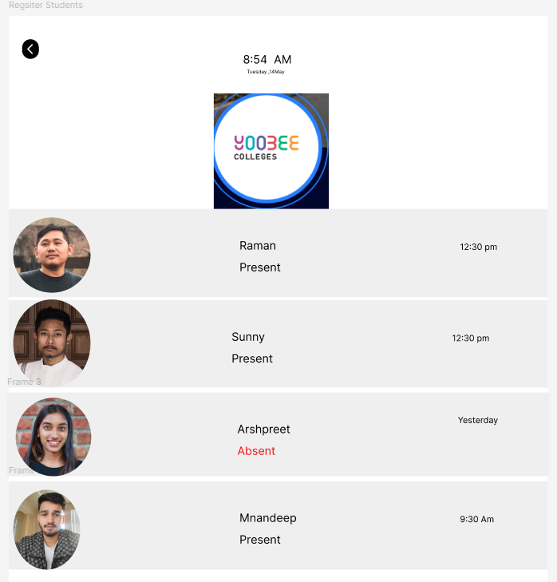
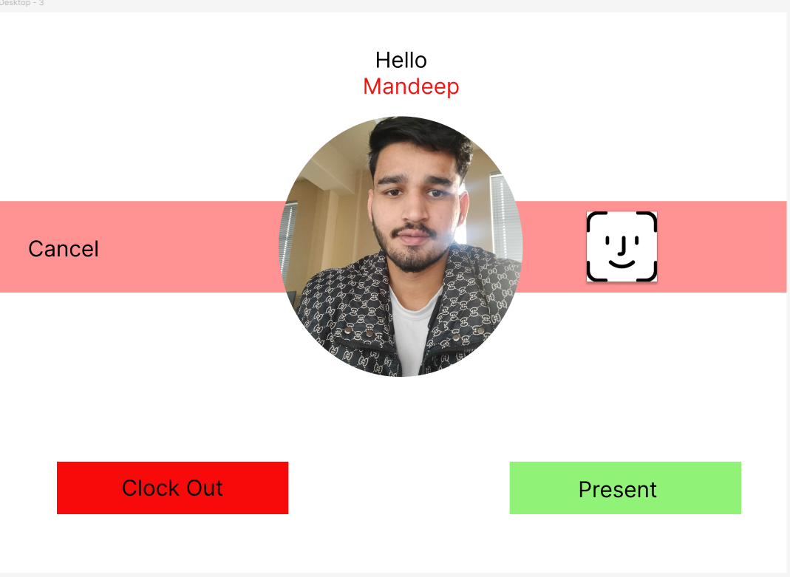
Notes:
Mandeep

Slide 28
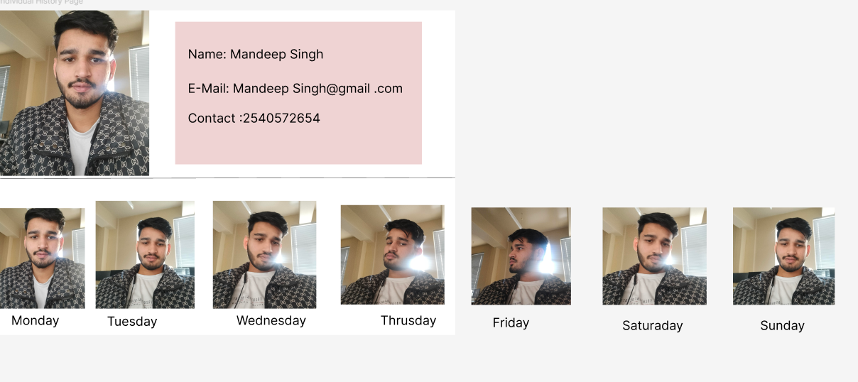
Notes:
Mandeep

Slide 29
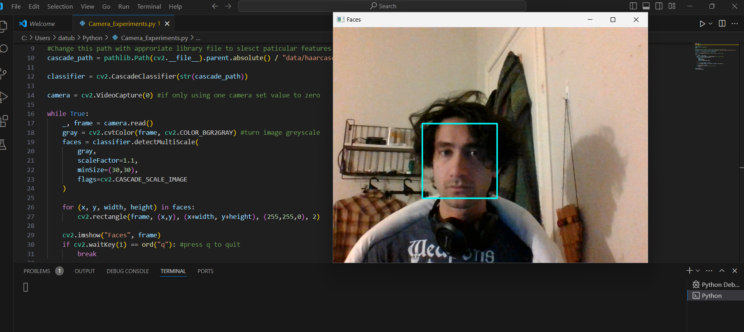
Proof of Concept Demo (OpenCV Face Detection)
Notes:
Datu

